Slide 1
Big Mountain Skiing Resort
Ticket price and features optimisation
- Kashyap

Slide 2
The problem

Slide 3
Problem Statement Worksheet (Hypothesis Formation)
Predict ticket prices to maximise revenue based on market information of 330 resorts,
and identify the facilities mix for the same .
H
1
Context
4
Constraints within solution space
Big Mountain resort is operating at a higher than average market price and with the lack of a data driven approach to pricing, there is a lack of insight over the right mix of facilities being offered.
There is considerable price variation based on location of different resorts, and would be difficult to capture this in modelling our prices
Data on T-bars and magic carpet is absent
5
Stakeholders to provide key insight
2
Criteria for success
Director of Operations- Jimmy Blackburn,
Alesha Eisen- the Database Manager.
Price of ticket is optimised, or even increased with same of more revenue at lesser costs.
3
Scope of solution space
6
Key data sources
Analysing the data to identify the correlation b/w the different facilities (such as type of chair lift), cost of ticket and the total runs, to arrive at a better facilities mix and ticket price for the resort
Our facilities: The facilities: 11 lifts, 2 T-bars, 1 magic carpet and an additional chair which increases their operating costs by $1,540,000
Our capacity: 105 trails, 350,000 annual footfall, 3.3 miles length, base elevation 4,464 ft, summit 6,817 ft, vertical drop of 2,353 ft. Similar data for the 330 resorts provided
H
D
E
I
P
Notes:
Hypothesis: Create a Hypothesis with an emphasis on SMART principles. (S – Specific, M – Measurable, A – Achievable, R – Realistic, T – Timebound). If you cannot do this, you do not have a good grasp on the business problem.
Context: With context, we have clearly identified the problem at hand and have elucidated on how our initiative may solve this problem, alongside the commercial implications this will have on the business.
Criteria for Success: Clearly defining the criteria for success ensures that the scope of your work is clearly defined and understood. Otherwise, if this isn’t defined – your work will never end which will result in mismatched expectations.
Scope of Solution Space: Scoping out the solution space ensures that the business initiative is SPECIFIC for a certain segment or area. This prevents solutions that have been developed being scaled and applied for all other business units that the solution may not be responsible or scalable for.
Constraints within Solution Space: Looking forward, what are the foreseeable problems we are likely to encounter? Could this be stakeholder resistance? Could this be we don’t have access to the right data?
Stakeholders to provide key insight: Who are the people I need to speak to, to get the answers I need for my data analysis?
What key data sources are required?
Based off my discussions with the key stakeholders – can we clearly list out all the data sources we need so we can make a highly targeted request as opposed to a scatter-gun approach where we ask for a bit of everything?

Slide 4
Recommendation and key findings
Modelled price is USD 92.80, Current price is USD 81.00.
Expected mean absolute error of $10.41
Recommendation: experiment with increased price

Slide 5
Modeling results and analysis

Slide 6
Data and exploratory insights
Raw data overview
Data issues and wrangling steps
330 rows, including our own resort
27 columns, from which 2 (AdultWeekday and AdultWeekend) could be target features
Silverton Mountain resort had a wrong entry for SkiableTerrain_ac of 26819 (only value > 10k sq mi), replaced it with the correct one as per Wiki: 1819
Fasteight column was dropped as it has ~50% missing values and rest are 0

Slide 7
Data transformations
Incorporating State
intelligence
Zeroing in on target variable
Aggregated State wise data and added population and state size data to create a new csv file, as the prices as well as other features looked state dependent.
Considered Weekend prices as the target feature as the values for weekend and weekday are almost equal for ticket prices >100 dollars (Including our resort), and it has less missing values.

Slide 8
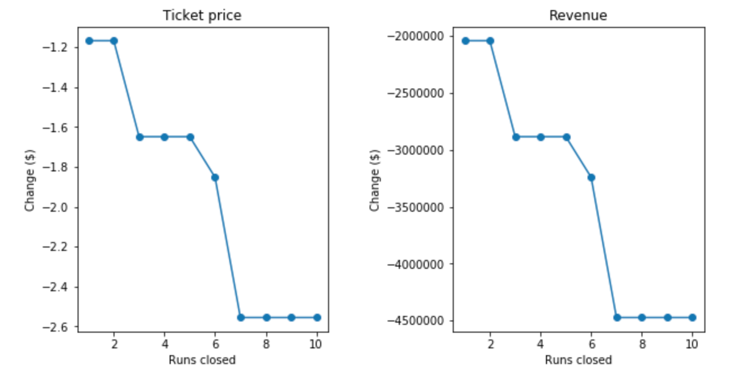
Scenario 1: dropping runs
Recommendation: suggest dropping one run in scenario 1 (Permanently closing down up to 10 of the least used runs), as the model suggests no change in price/ revenue. For further closes, the suggestion is to start with reducing 4 or 5 and observing the effect on prices/ revenue, as the model predicts almost the same drop for 2 through 4/5 run drops. Do not recommend further run deduction.

Slide 9
Scenario 2: Increase vertical drop
Recommend as the model predicts an increase in USD 1.33 per ticket, translating to USD 2,333,333 increase in revenue, assuming 350,000 visitors over the season, with an average of 5 tickets per visitor. Increased operating cost/ ticket for the additional chair is: 1,540,000/(5∗ 350,000) = $0.88
Increase the vertical drop by adding a run to a point 150 feet lower down but requiring the installation of an additional chair lift to bring skiers back up, without additional snow making coverage

Slide 10
Summary and conclusion
In summary, the model created predicts a higher ticket price, based on existing feature set.
Further usage of the model:
Predicting price increase based on changes to features: use the function 'predict_increase' in this notebook
Retraining and accounting for change in data: can retrain the model: 'ski_resort_pricing_model.pkl', pass different data for our resort, in case of changes

